Slide 1
Systematic Approaches to Building a Literature Review
Dr. Andrew R. Smolski
Postdoctoral Research Scholar
Department of Agricultural and Human Sciences
arsmolsk@ncsu.edu

Slide 2
Getting Started
Pull out a pen and paper. Take a moment, and think about the following question:
What problems have you confronted conducting a literature review?
Then, write down a few of the ideas that come to you. We will share these to start our conversation.

Slide 3
Basics

Slide 4
What is a literature review?
Summary and synthesis of extant literature
Can be an article
Criticism
State of the field
More likely a key part of an article
Positioning your paper
Demonstrating novelty

Slide 5
Types of Literature Reviews
Scoping Review – Broad search within a topic area to identify gaps, types of evidence, methodologies, and understand concepts
Systematic Review – Narrow search under specific parameters to understand current state of the field and evidence to guide best practices

Slide 6
Modified Meta-Study
Meta-study is a method to analyze and synthesize a large body of qualitative research
Interpretative approach to building knowledge from prior knowledge through a systematic content analysis
– assess contradictions and convergence
- assess change over time and shifting research priorities
Modification: For the purpose of literature review, quantitative and qualitative studies can be included – therefore, standardize annotation to handle both types – recognize will not be re-running statistics as in meta-analysis

Slide 7
Keyword Searches

Slide 8
Keywords
What keywords are you using?
How can you refine your keywords?
What topics do you want to conduct a literature review on?

Slide 9
Open Search
What do you do if you don’t have keywords?
Begin with your topic
Use references from articles that best match your topic
Build out a keyword table

Slide 10
Search Tricks
AND – both/and
OR – either/or
NOT – exclude
“…” – exact words
Farm* - will search for farm, farmer, farming, farms (uses the root)
~ - add a number to search for two terms in proximity within text
Use the sidebar
Adjust for years, discipline, subject terms, peer reviewed, etc.

Slide 11
Systematic Search
Providing clear parameters for your search
Pick an exact set of keywords
Pick a set of journals that typically publish on your topic
Within discipline
Interdisciplinary
Pick a timeframe to pull articles from
History of the topic
Contemporary state of the topic

Slide 12
Example: Environmental Sociology
Topic: Political Economy and the Environment
Keywords: “Ecological modernization”, “treadmill of production”, “treadmill of destruction”, “social metabolism”, “ecological unequal exchange”, “risk society”
Journals: 20 in total, both within discipline and interdisciplinary

Slide 13
Building a Keywork Table
Instructions:
In the GitHub, https://tinyurl.com/y94wafw6, there is a file labeled, “KeyWordSearchHandout”. Download that file for this activity. I will walk us through how to use the table as a tool for establishing a set of keywords to search for academic literature on your topic.

Slide 14
Synthesizing the literature

Slide 15
Conducting your own literature review
What general trend from your search could you organize your literature review around?
What is the big question your literature review is based upon? What is the narrower focus?
What is your ideal for your project? What pragmatic considerations should you account for?

Slide 16
Analyzing and Annotating
Focus on main points
Depending on purpose:
Document theory
Document methods
Document results
Build a coding system

Slide 17
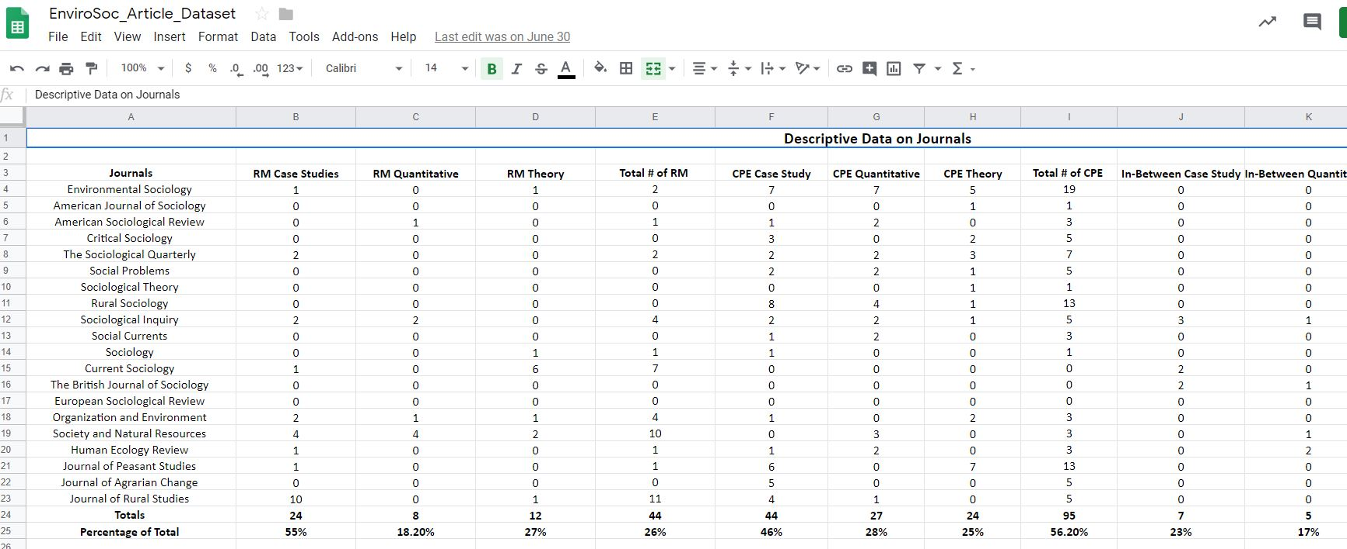
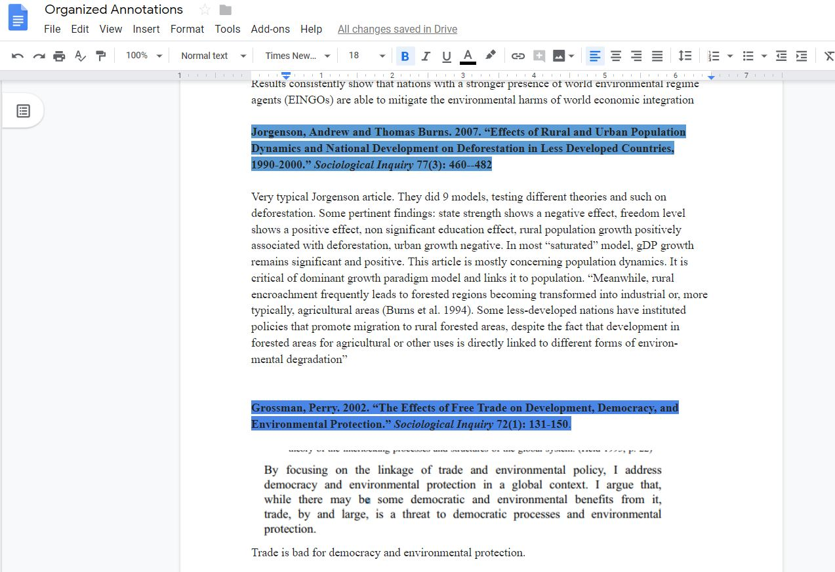
Example: Environmental Sociology
Annotations and Coding: Blue for CPE, Red for RM, Purple for Hybrid

Slide 18
More than Summarization, Synthesis
Summarizing
Represent the author’s argument, not a strawman
Present the main points without oversimplifying
Synthesizing
Fitting parts together to build a cohesive, whole
Novelty of the synthesis

Slide 19

Synthesis and Writing as an Iterative Process
Writing is not a linear process
Instead, writing is back-and-forth

Slide 20
Example: Environmental Sociology
Synthesis: Into theoretical mechanisms, agents/organizations involved, outcomes
Frameworks | Mechanisms | Outcomes
Reflexive Modernity | Technological Innovation Commodification (+) Institutional Reflexivity | Reducing Ecological Risk Risk Universalization
Critical Political Economy | Techno-Fix Commodification (-) Anti-Reflexivity | Increasing Ecological Risk Risk Stratification

Slide 21

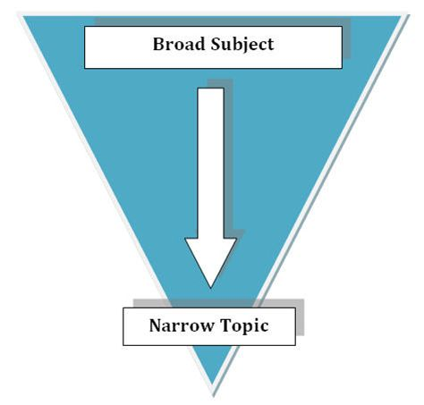
Strategies for Writing
Narrow to a manageable piece
Reverse Outline

Slide 22
Cool Down
Pull out a pen and paper. Take a moment, and think about the following question:
What is your writing process for a literature review? How does it compare and contrast with our discussion today?
Then, write down a few of the ideas that come to you. We will share these to start our conversation.

